Slide 1


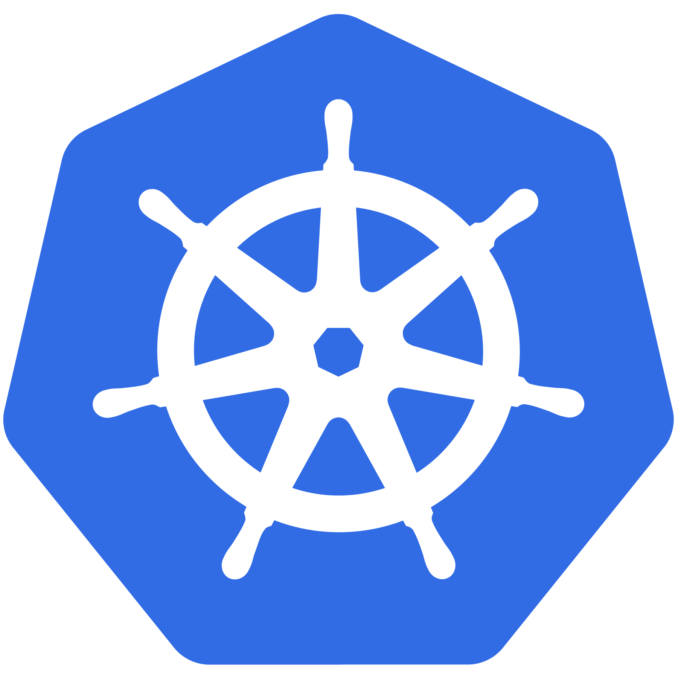
Kubernetes
Introduction to Services & Ingress

Slide 2
Agenda
What is a Service?
Service Types
ClusterIP
NodePort
LoadBalancer
Ingress
Name Based Routing
Path Based Routing

Slide 3
Services

Slide 4
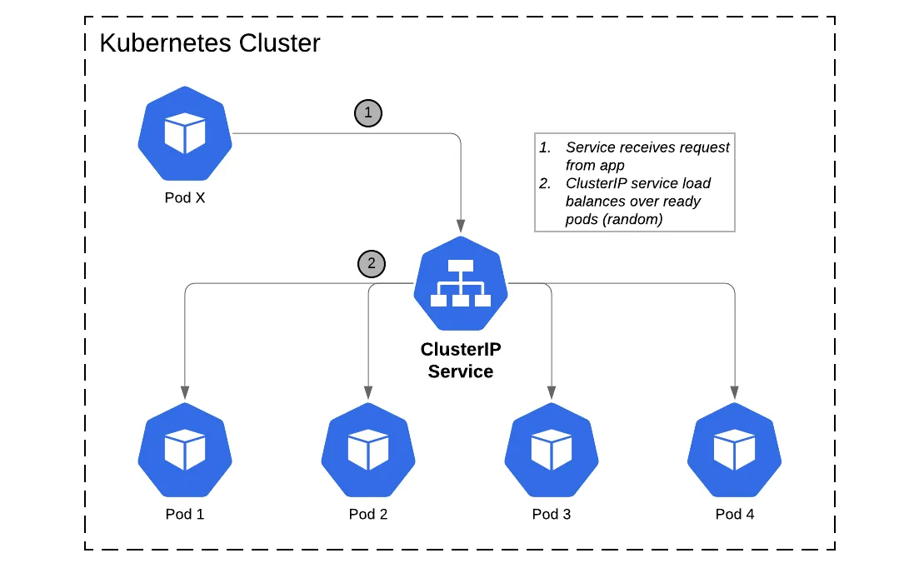

Slide 5
What is a Service?
Abstract way to expose an application running on a set of Pods
No “unfamiliar” service discovery mechanism
DNS name for a set of Pods, and can load-balance across them

Slide 6
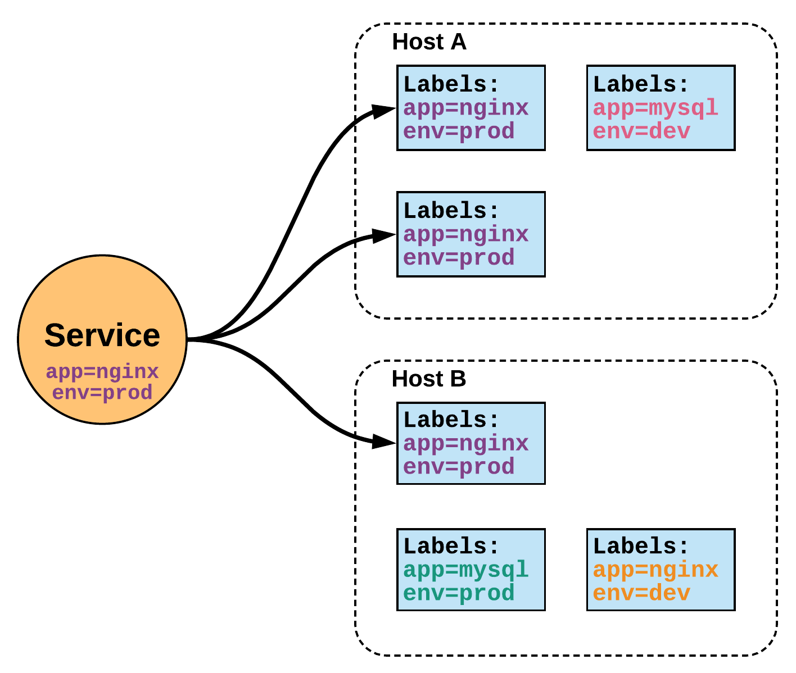
Services
Unified method of accessing the exposed workloads of Pods.
Durable resource
static cluster IP
static namespaced DNS name
<service name>.<namespace>.svc.cluster.local
Notes:
While this may seem like a technical definition, in practice it can be viewed more simply:
A service is an internal load balancer to your pod(s). You have 3 HTTP pods scheduled? Create a service, reference the pods, and (internally) it will load balance across the three.

Slide 7
Services
Target Pods using equality based selectors.
Uses kube-proxy to provide simple load-balancing.
kube-proxy acts as a daemon that creates local entries in the host’s iptables for every service.
Notes:
This in-turn acts as a simple round-robin load balancer among the Pods targeted by the selector.
More options coming

Slide 8
Service Types
There are 4 major service types:
ClusterIP (default)
NodePort
LoadBalancer
ExternalName

Slide 9
ClusterIP Service
ClusterIP services exposes a service on a strictly cluster internal virtual IP.
apiVersion: v1
kind: Service
metadata:
name: example-prod
spec:
selector:
app: nginx
env: prod
ports:
- protocol: TCP
port: 80
targetPort: 80
Notes:
ClusterIP is an internal LB for your application

Slide 10
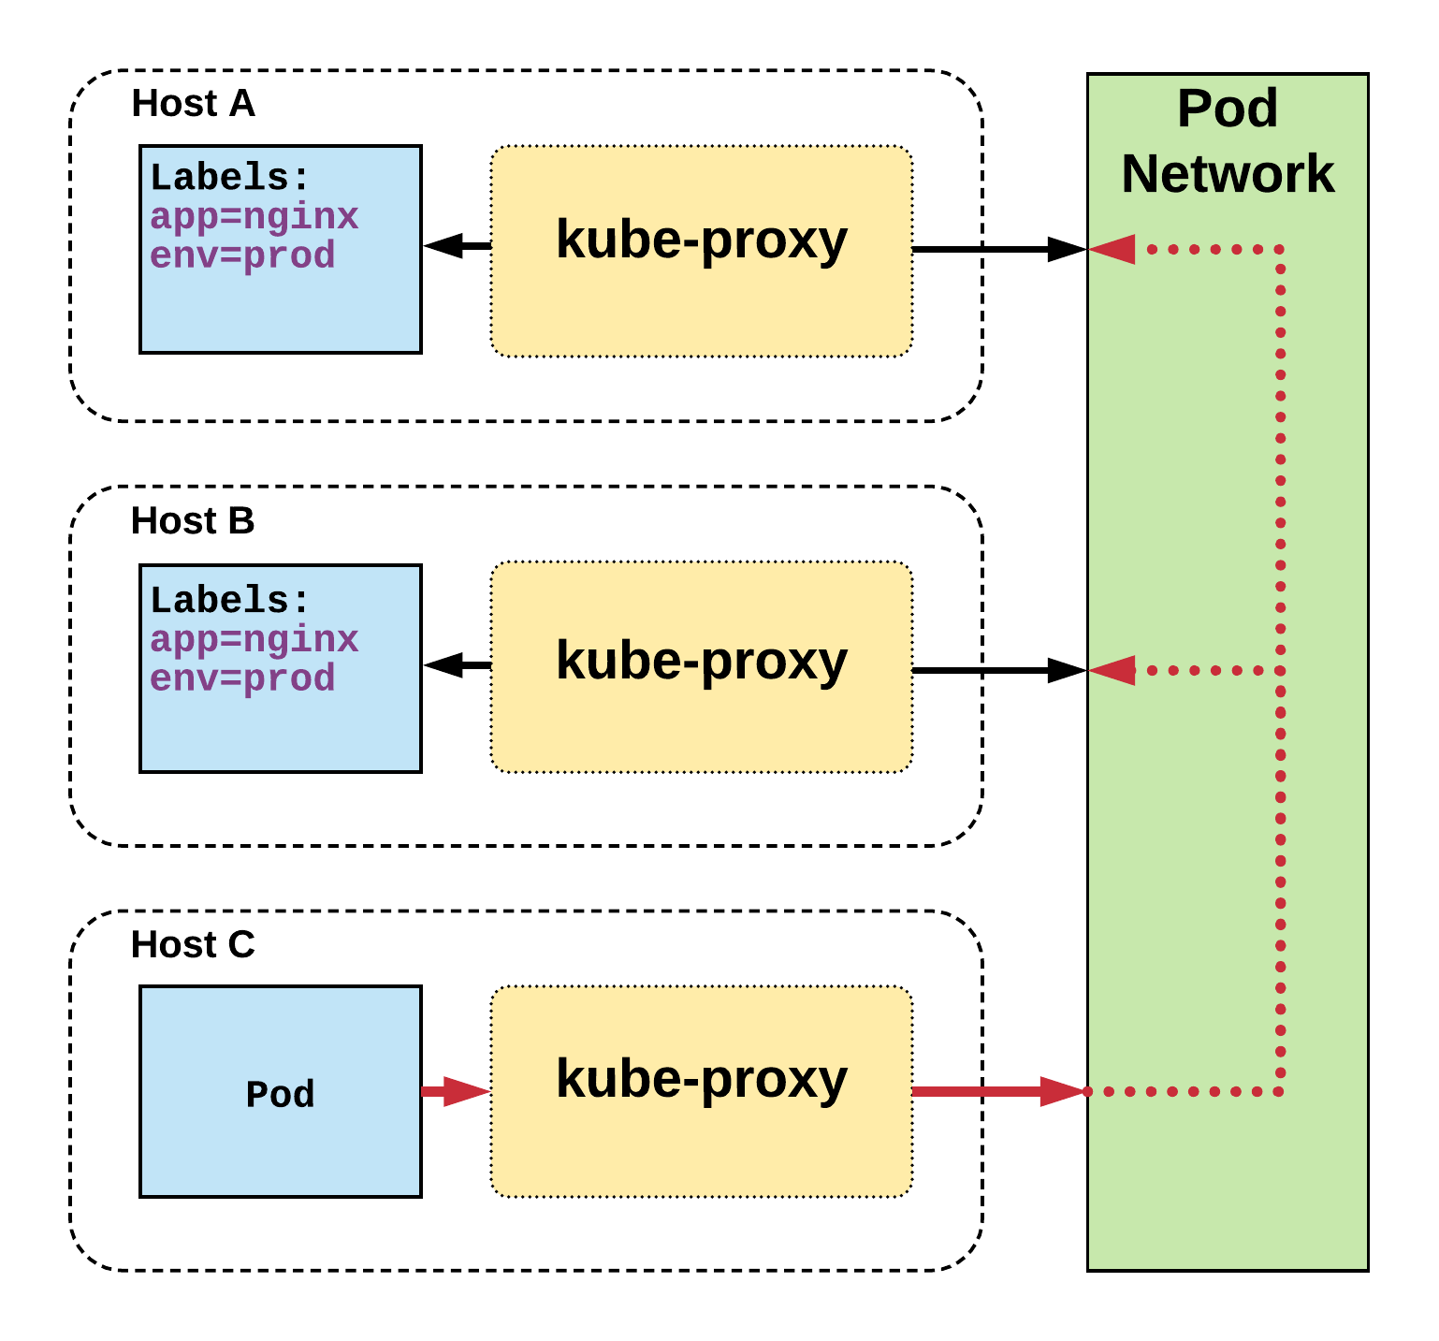
Cluster IP Service
Name: example-prod
Selector: app=nginx,env=prod
Type: ClusterIP
IP: 10.96.28.176
Port: <unset> 80/TCP
TargetPort: 80/TCP
Endpoints: 10.255.16.3:80, 10.255.16.4:80
/ # nslookup example-prod.default.svc.cluster.local
Name: example-prod.default.svc.cluster.local
Address 1: 10.96.28.176 example-prod.default.svc.cluster.local
Notes:
The Pod on host C requests the service
Hits host iptables and it load-balances the connection between the endpoints residing on Hosts A, B

Slide 11
NodePort Service
NodePort services extend the ClusterIP service.
Exposes a port on every node’s IP.
Port can either be statically defined, or dynamically taken from a range between 30000-32767.
apiVersion: v1
kind: Service
metadata:
name: example-prod
spec:
type: NodePort
selector:
app: nginx
env: prod
ports:
- nodePort: 32410
protocol: TCP
port: 80
targetPort: 80
Notes:
NodePort behaves just like ClusterIP, except it also exposes the service on a (random or specified) port on every Node in your cluster.

Slide 12
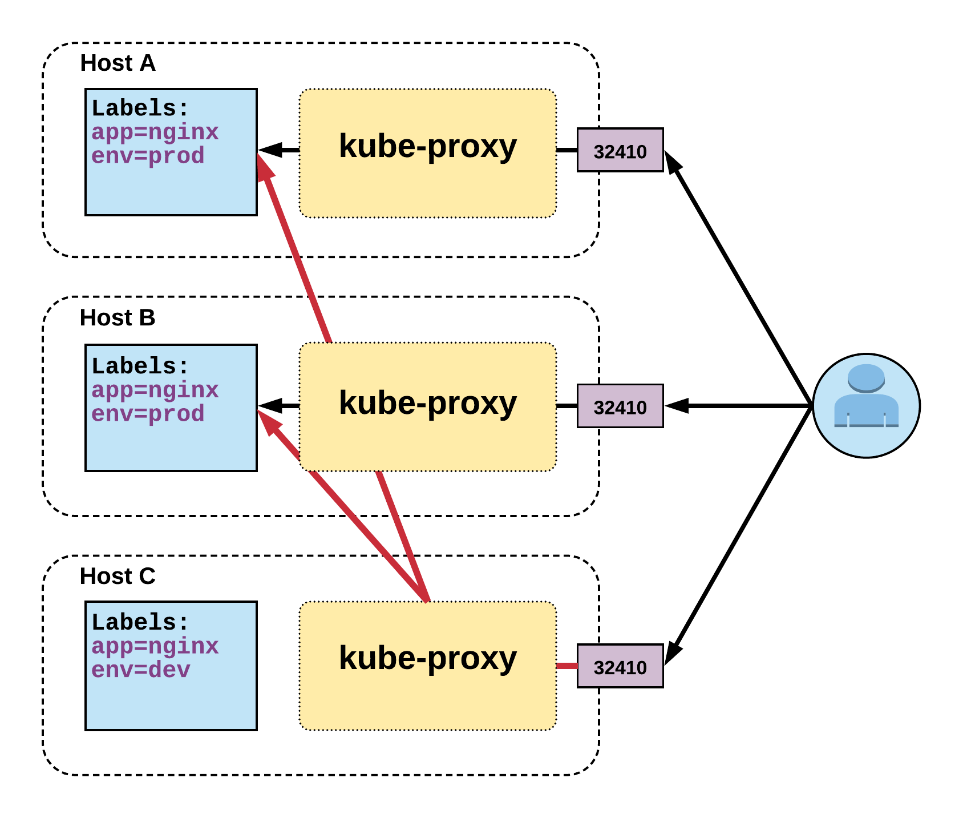
NodePort Service
Name: example-prod
Selector: app=nginx,env=prod
Type: NodePort
IP: 10.96.28.176
Port: <unset> 80/TCP
TargetPort: 80/TCP
NodePort: <unset> 32410/TCP
Endpoints: 10.255.16.3:80, 10.255.16.4:80
Notes:
User can hit any host in cluster on nodeport IP and get to service
Does introduce extra hop if hitting a host without instance of the pod

Slide 13
LoadBalancer Service
LoadBalancer services extend NodePort.
Works in conjunction with an external system to map a cluster external IP to the exposed service.
apiVersion: v1
kind: Service
metadata:
name: example-prod
spec:
type: LoadBalancer
selector:
app: nginx
env: prod
ports:
protocol: TCP
port: 80
targetPort: 80
Notes:
Continue to get abstracted and built on top of one another.
The LoadBalancer service extends NodePort turns it into a highly-available externally consumable resource.
-Must- Work with some external system to provide cluster ingress

Slide 14
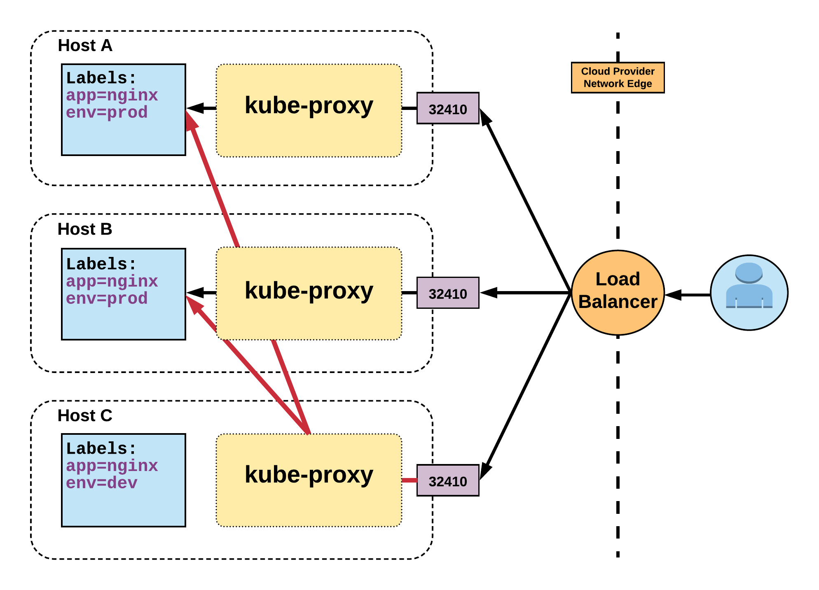
LoadBalancer Service
Name: example-prod
Selector: app=nginx,env=prod
Type: LoadBalancer
IP: 10.96.28.176
LoadBalancer Ingress: 172.17.18.43
Port: <unset> 80/TCP
TargetPort: 80/TCP
NodePort: <unset> 32410/TCP
Endpoints: 10.255.16.3:80, 10.255.16.4:80
Notes:
Gets external IP from provider
There are settings to remove nodes that are not running an instance of the pod. To remove extra hop.

Slide 15
ExternalName Service
ExternalName is used to reference endpoints OUTSIDE the cluster.
Creates an internal CNAME DNS entry that aliases another.
apiVersion: v1
kind: Service
metadata:
name: example-prod
spec:
type: ExternalName
spec:
externalName: example.com
Notes:
Allows you to point your configs and such to a static entry internally that you can update out of band later

Slide 16
Ingress

Slide 17
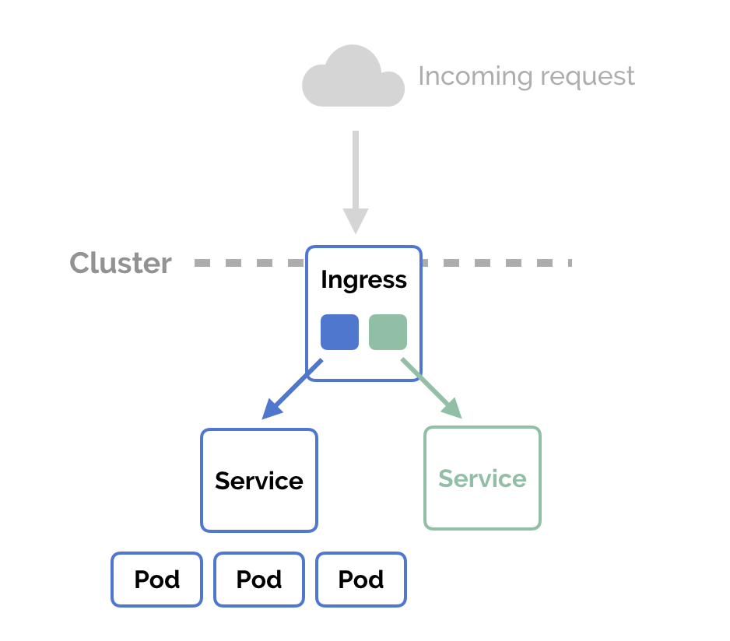

Slide 18
Ingress – Path Based Routing
An API object that manages external access to the services in a cluster
Provides load balancing, SSL termination and name/path-based virtual hosting
Gives services externally-reachable URLs
apiVersion: extensions/v1beta1
kind: Ingress
metadata:
name: simple-fanout-example
spec:
rules:
- host: foo.bar.com
http:
paths:
- path: /foo
backend:
serviceName: service1
servicePort: 4200
- path: /bar
backend:
serviceName: service2
servicePort: 8080
Notes:
Allows you to point your configs and such to a static entry internally that you can update out of band later

Slide 19
Ingress – Name Based Routing
apiVersion: extensions/v1beta1
kind: Ingress
metadata:
name: name-virtual-host-ingress
spec:
rules:
- host: first.bar.com
http:
paths:
- backend:
serviceName: service1
servicePort: 80
- host: second.foo.com
http:
paths:
- backend:
serviceName: service2
servicePort: 80
- http:
paths:
- backend:
serviceName: service3
servicePort: 80
foo.bar.com --| |-> foo.bar.com service1:80
| 178.91.123.132 |
bar.foo.com --| |-> bar.foo.com service2:80
Notes:
Allows you to point your configs and such to a static entry internally that you can update out of band later

Slide 20
Ingress Controllers
Ingress controllers are not started automatically with a cluster
Ingress controller implementations
GLBC
nginx
HA Proxy
traefik

Slide 21

Thank You
youtube.com/KuppiyaSL

